Slide 1
SQL FUNCTIONS and GROUP BY

Slide 2
Outline
Introduction
SQL Functions
COUNT
MAX
MIN
AVG
SUM
SQL GROUP BY

Slide 3
SQL Join
A JOIN clause is used to combine rows from two or more tables, based on a common key values between them.

Slide 4
transactions
transaction_id | amount | customer_id | order_date
1000 | 4.99 | 3 | 2025-01-01
1001 | 2.89 | 2 | 2025-01-01
1002 | 3.38 | 3 | 2025-01-02
1003 | 4.99 | 1 | 2025-01-02
1004 | 1.00 | null | 2025-01-03

Slide 5
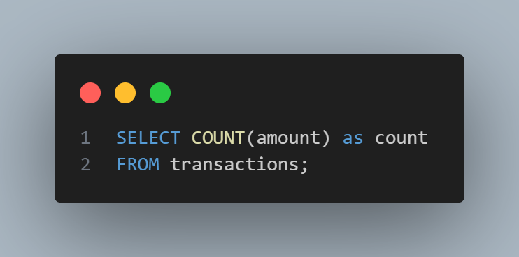
transactions
transaction_id | amount | customer_id | order_date
1000 | 4.99 | 3 | 2025-01-01
1001 | 2.89 | 2 | 2025-01-01
1002 | 3.38 | 3 | 2025-01-02
1003 | 4.99 | 1 | 2025-01-02
1004 | 1.00 | null | 2025-01-03
Result:
count
5

Slide 6
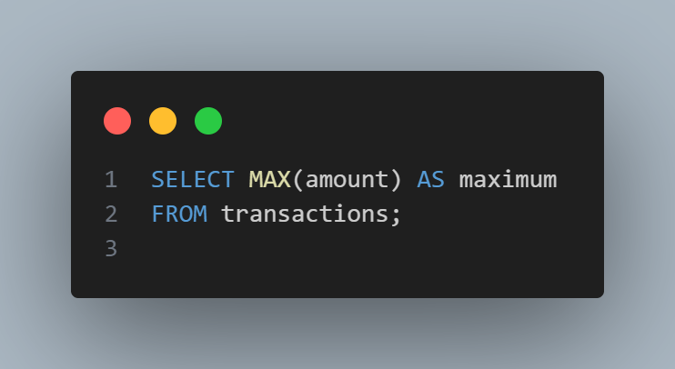
transactions
transaction_id | amount | customer_id | order_date
1000 | 4.99 | 3 | 2025-01-01
1001 | 2.89 | 2 | 2025-01-01
1002 | 3.38 | 3 | 2025-01-02
1003 | 4.99 | 1 | 2025-01-02
1004 | 1.00 | null | 2025-01-03
Result:
maximum
4.99

Slide 7
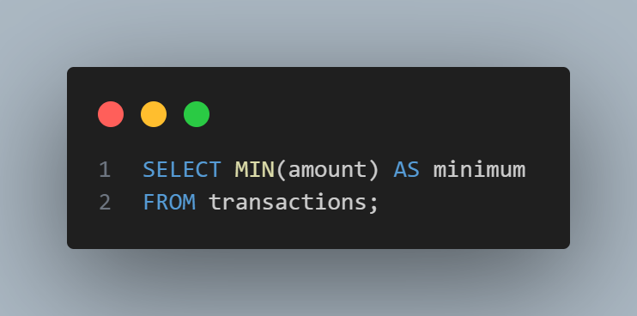
transactions
transaction_id | amount | customer_id | order_date
1000 | 4.99 | 3 | 2025-01-01
1001 | 2.89 | 2 | 2025-01-01
1002 | 3.38 | 3 | 2025-01-02
1003 | 4.99 | 1 | 2025-01-02
1004 | 1.00 | null | 2025-01-03
Result:
minimum
1.00

Slide 8
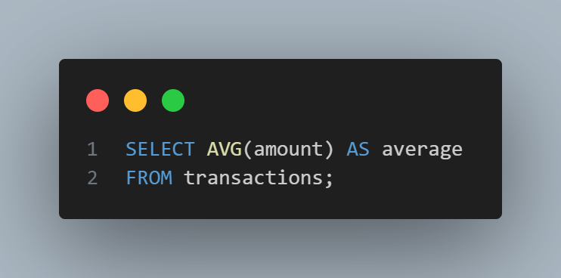
transactions
transaction_id | amount | customer_id | order_date
1000 | 4.99 | 3 | 2025-01-01
1001 | 2.89 | 2 | 2025-01-01
1002 | 3.38 | 3 | 2025-01-02
1003 | 4.99 | 1 | 2025-01-02
1004 | 1.00 | null | 2025-01-03
Result:
average
3.45

Slide 9

transactions
transaction_id | amount | customer_id | order_date
1000 | 4.99 | 3 | 2025-01-01
1001 | 2.89 | 2 | 2025-01-01
1002 | 3.38 | 3 | 2025-01-02
1003 | 4.99 | 1 | 2025-01-02
1004 | 1.00 | null | 2025-01-03
Result:
sum
17.25

Slide 10
transactions
transaction_id | amount | customer_id | order_date
1000 | 4.99 | 3 | 2025-01-01
1001 | 2.89 | 2 | 2025-01-01
1002 | 3.38 | 3 | 2025-01-02
1003 | 4.99 | 1 | 2025-01-02
1004 | 1.00 | null | 2025-01-03
1005 | 2.49 | 4 | 2025-01-03
1006 | 5.48 | null | 2025-01-03

Slide 11
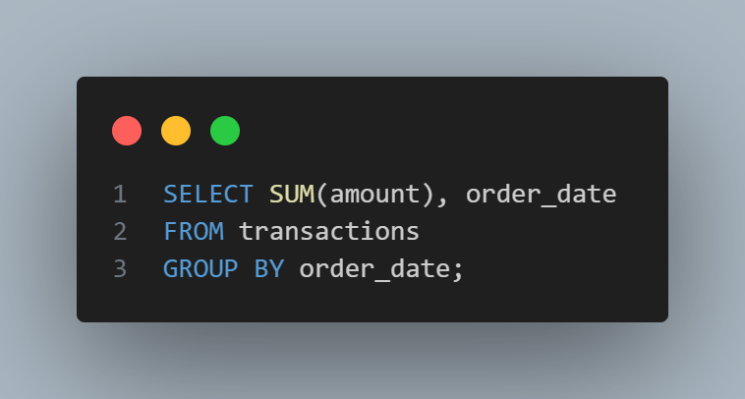
transactions
transaction_id | amount | customer_id | order_date
1000 | 4.99 | 3 | 2025-01-01
1001 | 2.89 | 2 | 2025-01-01
1002 | 3.38 | 3 | 2025-01-02
1003 | 4.99 | 1 | 2025-01-02
1004 | 1.00 | null | 2025-01-03
1005 | 2.49 | 4 | 2025-01-03
1006 | 5.48 | null | 2025-01-03
Result:
SUM(amount) | order_date
7.88 | 2025-01-01
8.37 | 2025-01-02
8.97 | 2025-01-03

Slide 12

transactions
transaction_id | amount | customer_id | order_date
1000 | 4.99 | 3 | 2025-01-01
1001 | 2.89 | 2 | 2025-01-01
1002 | 3.38 | 3 | 2025-01-02
1003 | 4.99 | 1 | 2025-01-02
1004 | 1.00 | null | 2025-01-03
1005 | 2.49 | 4 | 2025-01-03
1006 | 5.48 | null | 2025-01-03
Result:
MAX(amount) | order_date
4.99 | 2025-01-01
4.99 | 2025-01-02
5.48 | 2025-01-03

Slide 13

transactions
transaction_id | amount | customer_id | order_date
1000 | 4.99 | 3 | 2025-01-01
1001 | 2.89 | 2 | 2025-01-01
1002 | 3.38 | 3 | 2025-01-02
1003 | 4.99 | 1 | 2025-01-02
1004 | 1.00 | null | 2025-01-03
1005 | 2.49 | 4 | 2025-01-03
1006 | 5.48 | null | 2025-01-03
Result:
MIN(amount) | order_date
2.89 | 2025-01-01
3.38 | 2025-01-02
1.00 | 2025-01-03

Slide 14

transactions
transaction_id | amount | customer_id | order_date
1000 | 4.99 | 3 | 2025-01-01
1001 | 2.89 | 2 | 2025-01-01
1002 | 3.38 | 3 | 2025-01-02
1003 | 4.99 | 1 | 2025-01-02
1004 | 1.00 | null | 2025-01-03
1005 | 2.49 | 4 | 2025-01-03
1006 | 5.48 | null | 2025-01-03
Result:
AVG(amount) | order_date
3.940 | 2025-01-01
4.185 | 2025-01-02
2.990 | 2025-01-03

Slide 15
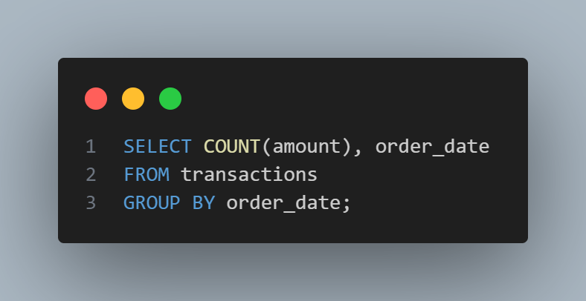
transactions
transaction_id | amount | customer_id | order_date
1000 | 4.99 | 3 | 2025-01-01
1001 | 2.89 | 2 | 2025-01-01
1002 | 3.38 | 3 | 2025-01-02
1003 | 4.99 | 1 | 2025-01-02
1004 | 1.00 | null | 2025-01-03
1005 | 2.49 | 4 | 2025-01-03
1006 | 5.48 | null | 2025-01-03
Result:
COUNT(amount) | order_date
2 | 2025-01-01
2 | 2025-01-02
3 | 2025-01-03

Slide 16

transactions
transaction_id | amount | customer_id | order_date
1000 | 4.99 | 3 | 2025-01-01
1001 | 2.89 | 2 | 2025-01-01
1002 | 3.38 | 3 | 2025-01-02
1003 | 4.99 | 1 | 2025-01-02
1004 | 1.00 | null | 2025-01-03
1005 | 2.49 | 4 | 2025-01-03
1006 | 5.48 | null | 2025-01-03
Result:
COUNT(amount) | customer_id
2 | null
1 | 1
1 | 2
2 | 3
1 | 4

